Slide 1
PRODUCT LABEL READING FOR VISUALLY IMPAIRED PEOPLE Made By: Pramod Garad (BE18F04F010) Ashutosh Shankarwar (BE18F04F053) Pratik Thombre (BE18F04F055)

Slide 2
AGENDA:
INTRODUCTION
LITERATURE REVIEW
BLOCK DIAGRAM
CIRCUIT DIAGRAM
SPECIFICATIONS
ROADMAP
CONCLUSION

Slide 3
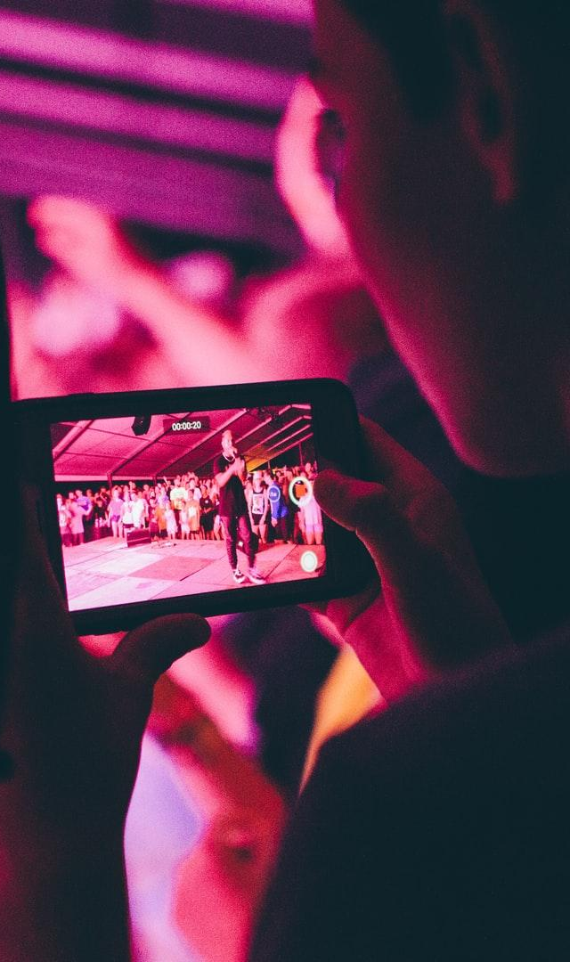
INTRODUCTION
1) Our SENSES helps us to interact with the External World.
2) But not everyone is lucky to have them working in the best conditions.
3) There are 314M visually impaired people in the world and 45M are blind.
4) Development in computer vision, digital cameras make it feasible to assist these individuals.

Slide 4
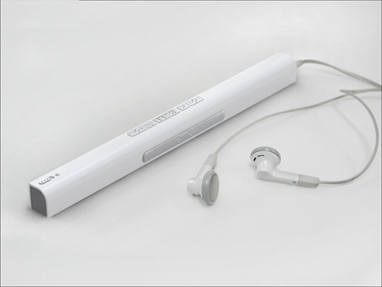
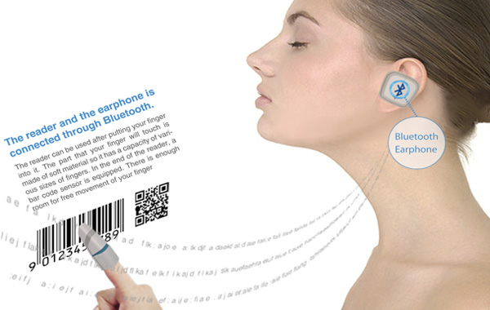
INTRODUCTION
5) There are already few such systems available but most of the are not user friendly.
6) So here we propose a system that would assist the visually impaired people with reading the labels in ease and fast way.

Slide 5
LITERATURE REVIEW
1) Chucai Yi, Yingli Tian and Aries Arditi ,”Portable Camera-Based Assistive Text and Product Label Reading From Hand-Held Objects for Blind Persons”.

Slide 6
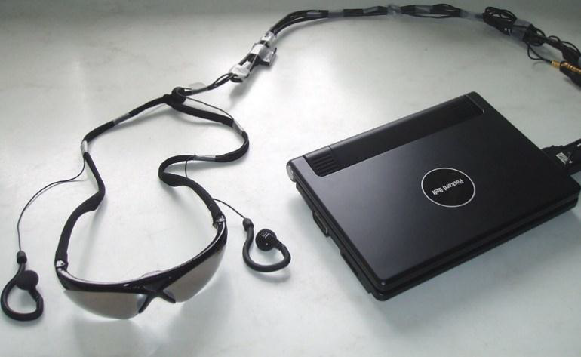
LITERATURE REVIEW
2) Rahulkumar Chhatwani, Arvind Langhe, Akash Tikhe, Akshaysingh Chouhan and Prof. S.V. Dabhade “Product Label Reading System for visually challenged people ”

Slide 7
PILLARS OF PROPOSED IDEA
LABEL
CAPTURE
IMAGE
PROCESSING
AUDIO
OUTPUT

Slide 8
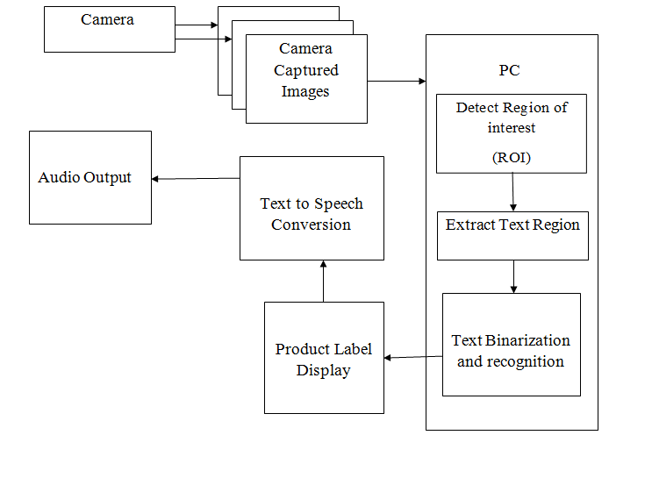
BLOCK DIAGRAM

Slide 9
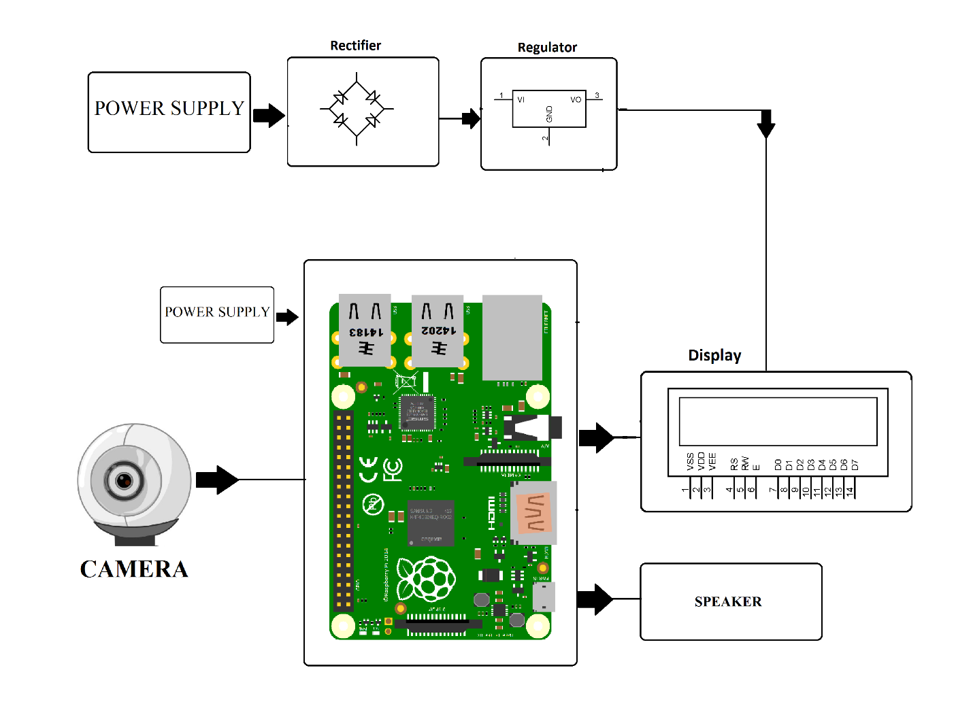
CIRCUIT DIAGRAM

Slide 10
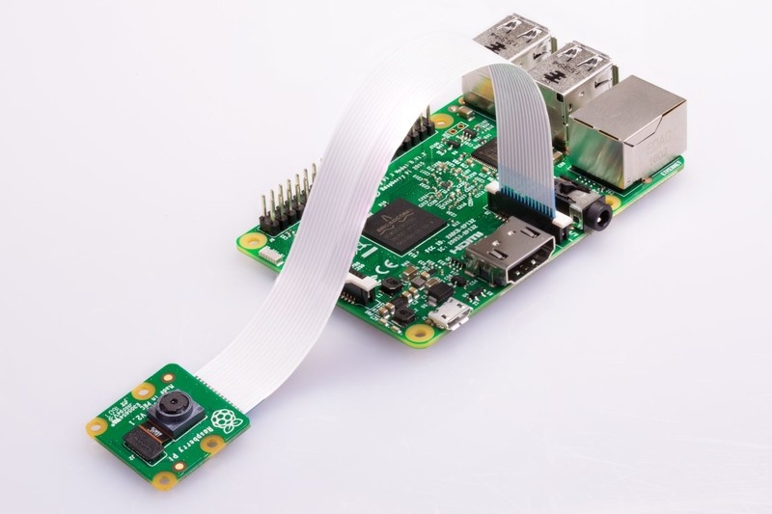
COMPONENTS SPECIFICATIONS
Weight = 3g
Still Resolution = 8MP
Format = JPEG, GIF, PNG,etc.
Sensor = Sony IMX219
Focal Length = 3.04 mm
RASPBERRY PI
CAM MODULE
V2

Slide 11
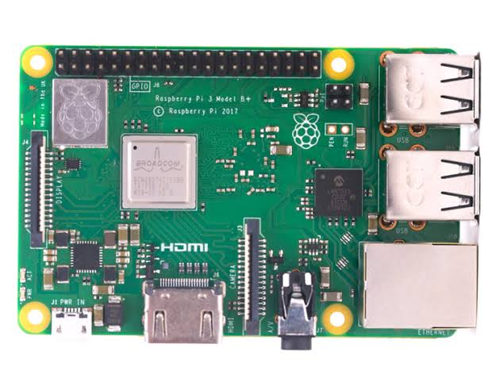
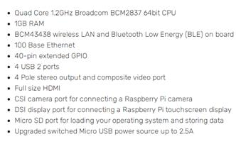
COMPONENTS SPECIFICATIONS
Raspberry Pi 3 Model B

Slide 12
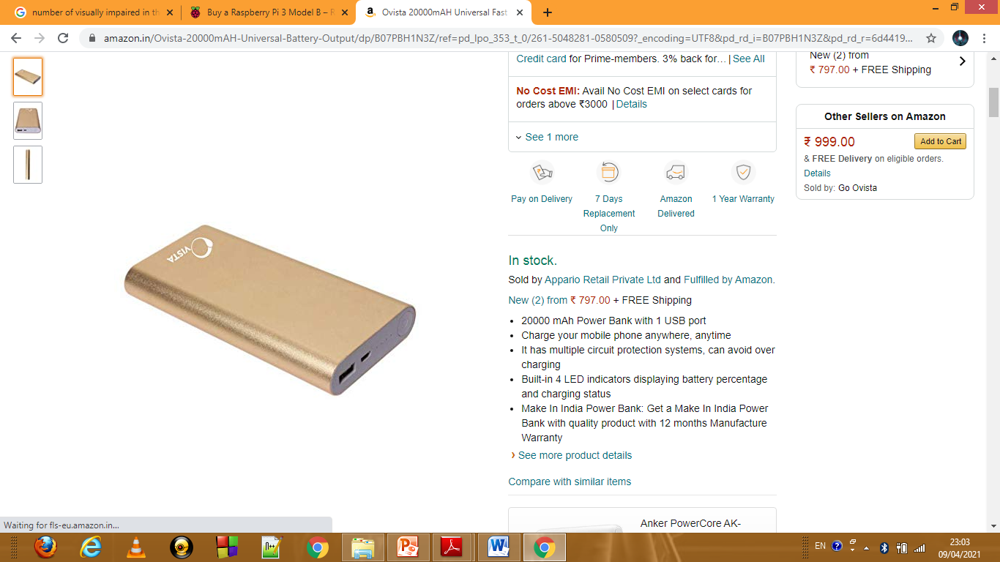
COMPONENTS SPECIFICATIONS
Voltage Output = 5 V
Current Output = 2 A
Dimensions = 17 x 8.4 x 3.6 cm
Capacity = 20000mah
Manufacturer = Ovista
Power Bank

Slide 13
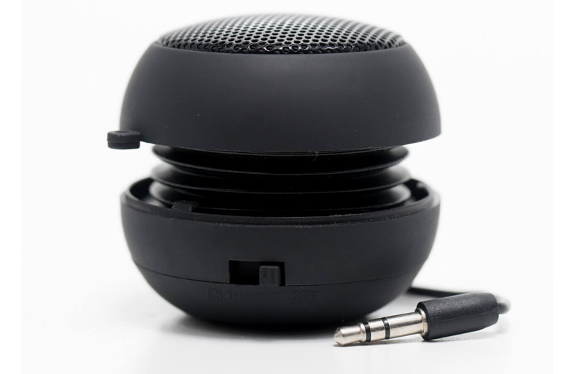
COMPONENTS SPECIFICATIONS
Connects = Aux jack on Raspberry Pi
Power = Self battery powered
Charging = Via USB
Setup Type = Plug And Play
Raspberry pi Speaker

Slide 14



SOFTWARE USED

Slide 15
ROADMAP
Component selection and Design of circuit
Integrating Image Processing and Audio outputs
Testing and Debugging
1
3
5
START
1
2
4
6
Understanding of Image Processing and Audio Outputs
Coding into raspberry pi
Report Formation

Slide 16
EXPECTED COSTING
COMPONENTS | PRICE
RASPBERRY PI 3 MODEL B | 2700
RASPBERRY PI CAM | 2300
DEXTER INDUSTRY SPEAKER | 700
POWER BANK | 1000
TOTAL | 6700

Slide 17
FUTURE SCOPE
In Future a more compact system could be developed using higher processor and wireless communications between the camera and image processing unit so as the person using the device has to carry only a smaller circuit everywhere.
Doing this would be more user friendly and thus cost efficient.
But the major problem that has to be tackled are difficult processor programming and wireless data transmission.

Slide 18

CONCLUSION
Here we conclude that our system is a good alternative to the current available solutions.
Also working over these advance topics would help us
Understand image processing
And data processing in a better way

Slide 19
REFERENCES
Research paper
YouTube
Google
“Product Label Reading System for visually challenged people”
Rahulkumar Chhatwani, Arvind Langhe, Akash Tikhe , Akshaysingh Chouhan and Prof. S.V. Dabhade
Product Label Reading System For Visually Challenged People
https://www.youtube.com/watch?v=1GuSQv4-lEg&t=274s
How to convert picture to sound in Python
https://kalebujordan.com/image-to-sound-in-python/

Slide 20
THANK YOU

